Slide 1

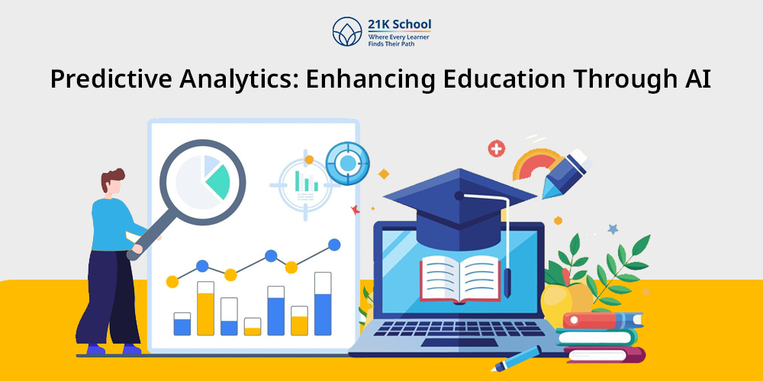
STUDENT PERFORMANCE PREDICTION
Using Machine Learning to Understand How Daily Habits Impact Academic Success
PRESENTED BY
DEEP MAHAPATRA(10300223056)
ANIKET MAITI(10300223021)

Slide 2









PROJECT OVERVIEW
This project predicts student exam performance using Machine Learning analysis of daily lifestyle habits. By examining patterns in study routines, sleep schedules, social media usage, and wellness factors, our system provides personalized insights into academic outcomes.
The web application transforms complex data into actionable intelligence, helping students make informed decisions about their study habits and time management strategies.
Study Hours
Social Media
Daily learning time tracking
Digital engagement patterns
Sleep Quality
Mental Health
Rest and recovery analysis
Wellness and stress levels

Slide 3

PROJECT OBJECTIVES
PREDICT EXAM SCORES
BUILD WEB APPLICATION
01.
03.
Accurate performance forecasting using advanced Machine Learning models
Create a real-time, accessible prediction system for students
HABIT AWARENESS
MERGE ML & WEB DEV
02.
04.
Provide real-time insights into how daily choices impact academic outcomes
Demonstrate seamless integration of data science and application development

Slide 4






THE PROBLEM WE'RE SOLVING
CURRENT CHALLENGE
Students often lack visibility into how daily behaviors affect their academic performance. Without data-driven feedback, it's difficult to identify harmful patterns or optimize study routines effectively.
Clear concepts for confident decisions
OUR SOLUTION
Collect comprehensive habit data through simple interfaces
Apply predictive Machine Learning algorithms
Generate instant expected exam score feedback
Enable proactive academic performance management

Slide 5





MACHINE LEARNING APPROACH
Random Forest Regressor
A powerful ensemble learning method that combines multiple decision trees to produce accurate predictions while minimizing overfitting risks.
Why This Algorithm?
Precision
Delivers accurate predictions for continuous values
Multi-feature Handling
Manages diverse input variables effectively
Robustness
Reduces overfitting through ensemble averaging

Slide 6
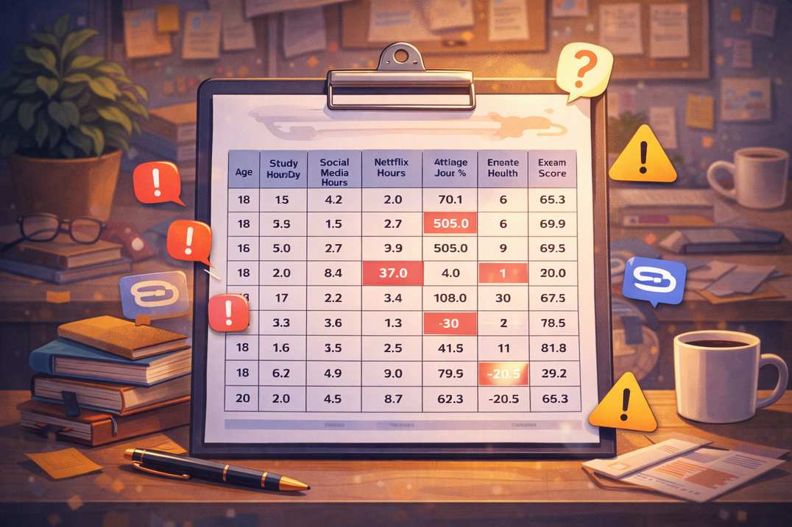







DATASET & DATA PROCESSING
MODEL TRAINING PROCESS
DATA LOADING
Dataset collection and cleaning procedures
DATA CONVERSION
Transform data to numeric format
DATA CLEANING
Remove missing values and outliers
DATA SPLIT
Split into training and testing sets
Key Parameters
Age demographic
Daily study hours
Social media usage
Netflix viewing time
Attendance percentage
Sleep duration
Exercise frequency
Mental health rating
Exam score (target)
MODEL TRAINING
Train Random Forest model
MODEL SAVE
Save model as model.pkl

Slide 7










HTML STRUCTURE
CSS STYLING
Semantic markup for content organization
Responsive design and UI polish
WEB APPLICATION DEVELOPMENT
JAVASCRIPT
FLASK BACKEND
Dynamic interactions and user experience
Web framework handling requests
PYTHON ML
Machine Learning model integration

Slide 8








WEBSITE FEATURES
SYSTEM WORKFLOW
01
USER INPUT
Enter student details through web form
02
BACKEND PROCESSING
Data sent to Flask backend for validation
03
ML PREDICTION
CORE FEATURES
Model analyzes patterns and generates score
User-friendly interface designed for intuitive navigation
Easy habit input through simple form fields
Real-time prediction engine with instant results
Responsive design works on any device
Score visualization with intuitive progress bars
04
RESULTS DISPLAY
Visual score presentation with insights

Slide 9

EXPECTED BENEFITS
Student Impact
HABIT OPTIMIZATION
01
Identify which daily behaviors most impact exam performance, enabling targeted improvements in study routines and time management
EARLY WARNING
02
Receive performance predictions before exams, allowing time to adjust habits and strategies for better outcomes
DATA-DRIVEN AWARENESS
03
Understanding concrete connections between lifestyle choices and academic results promotes healthier habits
EDUCATIONAL INSIGHTS
04
Institutions can analyze patterns across student populations to identify systemic issues and implement targeted support programs

Slide 10


92%
CONCLUSIONS
This project successfully demonstrates how Artificial Intelligence can directly benefit students by transforming complex lifestyle patterns into actionable academic insights. By combining Machine Learning with educational data analysis and web development, we've created a system that empowers students to optimize their study habits and achieve their academic potential.

Slide 11


THANK YOU VERY MUCH!

